Slide 1
Syngene International
Q1 FY26 Earnings Call
24 July 2025

Slide 2


Safe Harbor Statement
Certain statements in this release concerning our future growth prospects are forward-looking statements, which are subject to a number of risks, uncertainties and assumptions that could cause actual results to differ materially from those contemplated in such forward-looking statements.
Important factors that could cause actual results to differ materially from our expectations include, amongst others general economic and business conditions in India, business outlook of our clientele and their research and development efforts, our ability to successfully implement our strategy, our growth and expansion plans and technological changes, changes in the value of the Rupee and other currencies, changes in the Indian and international interest rates, change in laws and regulations that apply to the Indian and global biotechnology and pharmaceuticals industries, increasing competition, changes in political conditions in India and changes in the foreign exchange control regulations in India.
Neither the Company, nor its directors and any of the affiliates have any obligation to update or otherwise revise any statements reflecting circumstances arising after this date or to reflect the occurrence of underlying events, even if the underlying assumptions do not come to fruition.

Slide 3
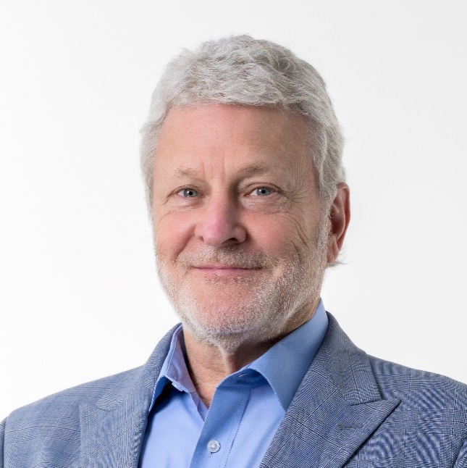
CEO Remarks
Peter Bains
Managing Director & CEO
Syngene International Limited

Slide 4



Q1 FY26: Financial performance in line with expectations
Revenue from operations
Sales Split
INR 875 Cr ( 11% Y-o-Y)
~ 7% increase in constant currency terms
Driven by Research services
Operating EBITDA & Margin
Operating EBITDA INR 206 Cr ( 21% Y-o-Y)
Operating EBITDA Margin 24% vs 22% in Q1 FY25
Driven by revenue growth and change in business mix
Reported PAT Growth*
INR 87 Cr ( 59% Y-o-Y)
Before exceptional items**
**Excludes exceptional item of Rs. 21 crores (net of tax) in Q1 FY25 relating to final settlement from an insurance claim

Slide 5
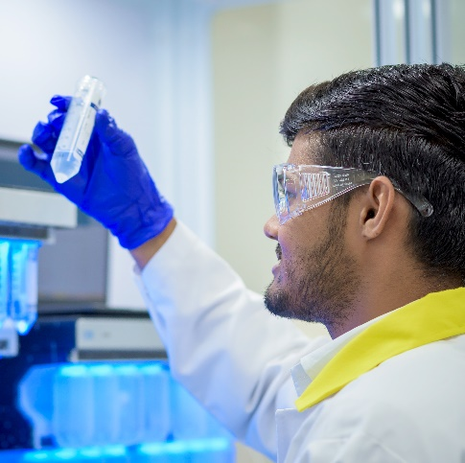


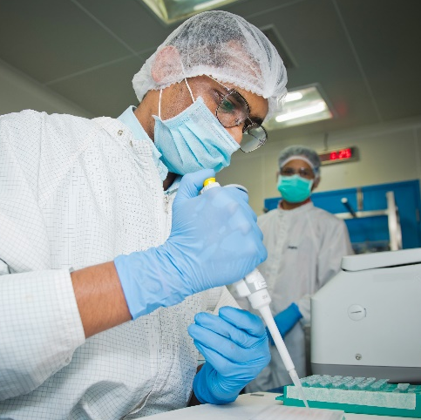


Segment Highlights: Research Services
Successful transition of pilot programs into longer-term contracts
Inauguration of a new state-of-the-art, dedicated peptide laboratory
20+
Concluded over 20 client and regulatory audits during the quarter
Biotech funding still volatile – we remain agile in our response
Good Clinical Practices + Biologics facility received EIR with favorable closure
Automation of DMPK operations has reduced TAT, and improved efficiency
Continue to receive healthy interest from large sized pharma companies in the form of RFPs

Slide 6
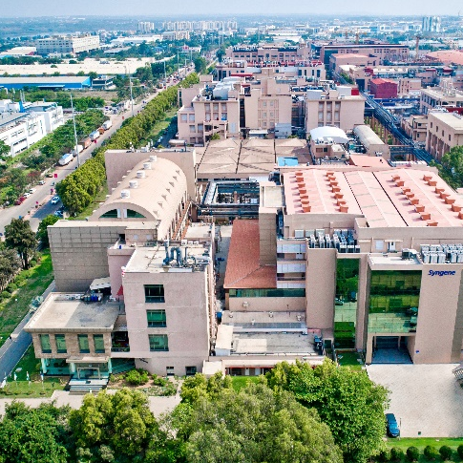
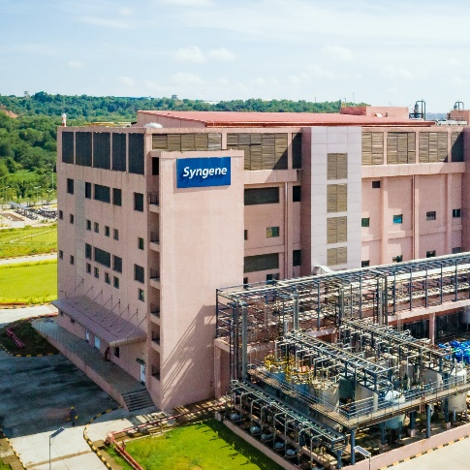

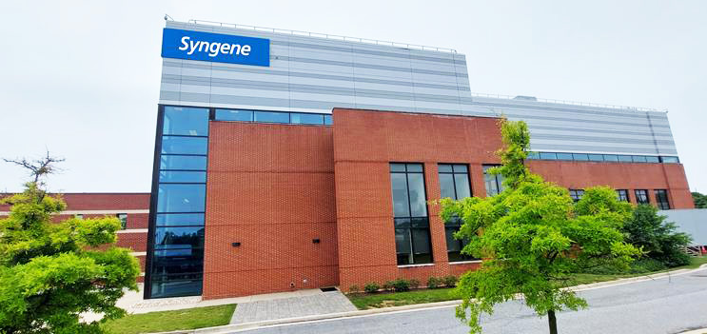
Segment Highlights: CDMO Services
Unit III, Bengaluru: Syngene’s biologics facility became operational
SM facility, Mangaluru: increasing capacity utilization and pipeline development
Delivered a resilient performance this quarter
Bayview facility, US: revalidation and integration on track

Slide 7
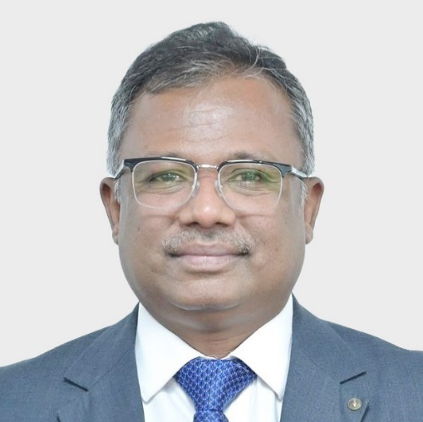
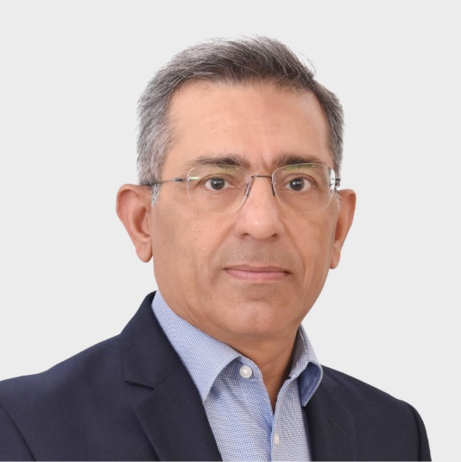
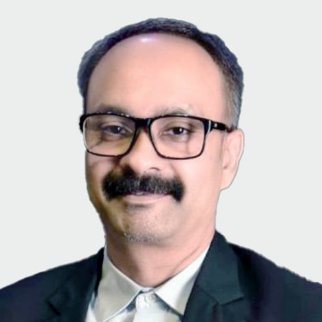
Leadership Appointments
Priyaranjan Patnaik
Vice President, Discovery Biology
Ajay Tandon
Head, Strategy & Corporate Development
Gaurav Kushwaha
Chief Technology Officer​

Slide 8
Leadership Appointments
Priyaranjan Patnaik
Vice President, Discovery Biology
Gaurav Kushwaha
Chief Technology Officer​
Ajay Tandon
Head, Strategy & Corporate Development

Slide 9

Proud to be recognized by TIME Magazine and Statista as one of the
World’s Most Sustainable Companies, 2025
Syngene ranked
#1 in India, Pharma and Biotech sector
Global Top 20, Pharma and Biotech sector

Slide 10
CEO’s Concluding Remarks
We are encouraged by a positive start to the financial year
While we remain mindful of ongoing macroeconomic factors, we maintain a confident outlook

Slide 11
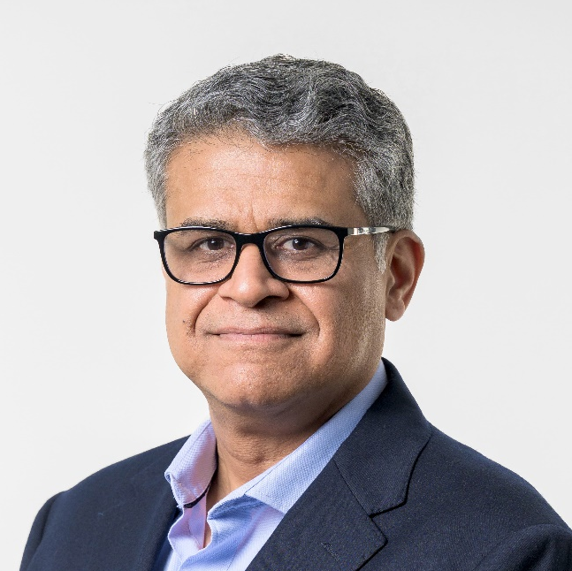
CFO Remarks
Deepak Jain
Chief Financial Officer
Syngene International Limited

Slide 12
Q1 FY26: Positive start to the year with y-o-y growth trajectory
Q1 FY26 Revenue from Operations (INR Cr)
+11% Y-o-Y
Q1 FY26 growth
+11% Y-o-Y (reported currency)
+7% Y-o-Y (constant currency)
Continued growth momentum in Research Services conversion of pilots in discovery services and ramp up by existing clients
Resilient performance in CDMO business

Slide 13
Costs and Profitability
% of Revenue from operations
Reported PAT before exceptional items (INR Cr)
 |  | Q1 FY25 |  | Q1 FY26 |  | Y-o-Y Change
Operating EBITDA Margin |  | 22% |  | 24% |  | ~200 bps
Raw material cost |  | 30% |  | 25% |  | -7%
Staff cost |  | 32% |  | 33% |  | 15%
Other Direct cost |  | 3% |  | 3% |  | 2%
Other Expenses |  | 13% |  | 15% |  | 22%
Hedge (gain) / loss |  | 0% |  | 1% |  | 44%
+59% Y-o-Y
Operating EBITDA increased by 21% Y-o-Y with margins at 24% this quarter vs 22% same quarter last year
Adjusting for one-off tax gain of Rs 6.8 Cr on transfer of gratuity funds to Employee Gratuity Trust. PAT before exceptional items and one-offs grew by 47% Y-o-Y in Q1 FY26

Slide 14
Capex summary: USD 8mn invested in Q1 FY26
Q1 FY26

Slide 15
Guidance for full year FY26 maintained
Overall Syngene | FY26 Guidance given
Revenue from Ops Growth | Mid Single digit
Operating EBITDA Margin | Mid 20s
PAT growth before exceptions | Negative
Capex (USD Mn) | 55
Underlying Revenue Growth
(ex inventory rebalancing in biologics commercial manufacturing)
Early teens

Slide 16
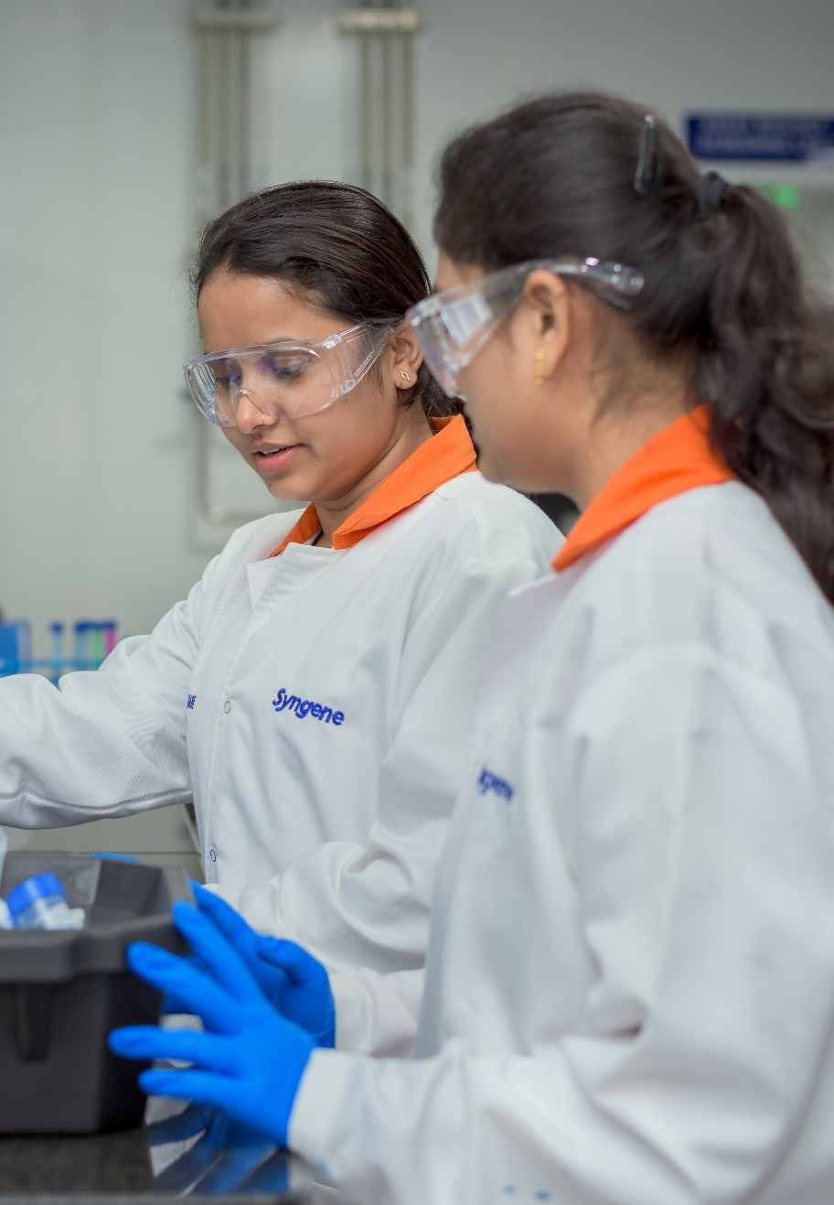
Q&A

